Slide 1


Sales Performance Analysis of Walmart Stores Using Advanced MySQL Techniques
Presented by: Vandana Bhavsar
Internshala Trainings Project 1-sep-2025

Slide 2

Project Overview
This project analyzes detailed transaction data from multiple Walmart branches to uncover actionable insights into sales patterns, customer behavior, and operational efficiency.
Dataset: Contains rich information on customer demographics, product lines, sales figures, and payment methods.
Objective: To employ advanced MySQL techniques to answer critical business questions and inform strategic decisions.
Business Problem
Walmart aims to optimize its sales strategies. By analyzing historical data, we can identify key trends and performance indicators related to:
Sales Performance: Which branches and products are performing best?
Customer Segmentation: How do different customer types behave?
Product & Payment Trends: What are the most popular products and payment methods?

Slide 3
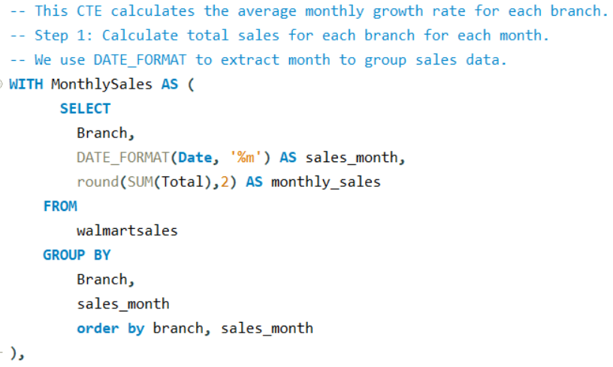
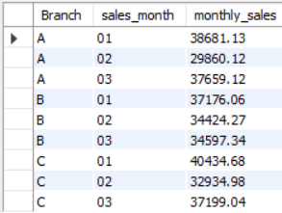
Task 1: Identifying the Top Branch by Sales Growth Rate
Business Question: Which branch has exhibited the highest sales growth over time?
OUTPUT

Slide 4
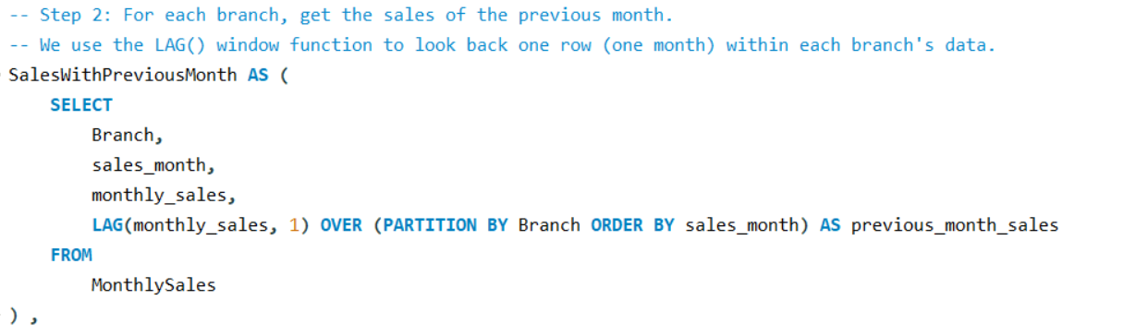
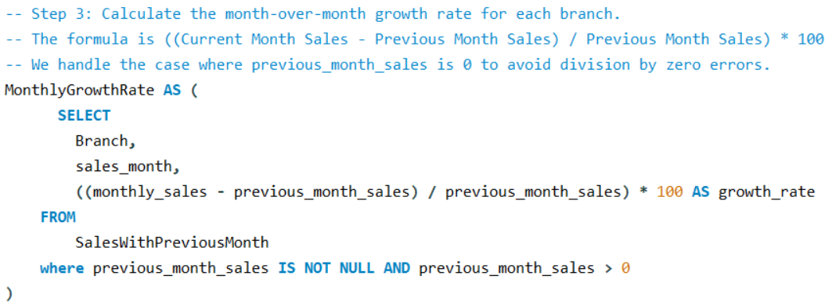

Slide 5
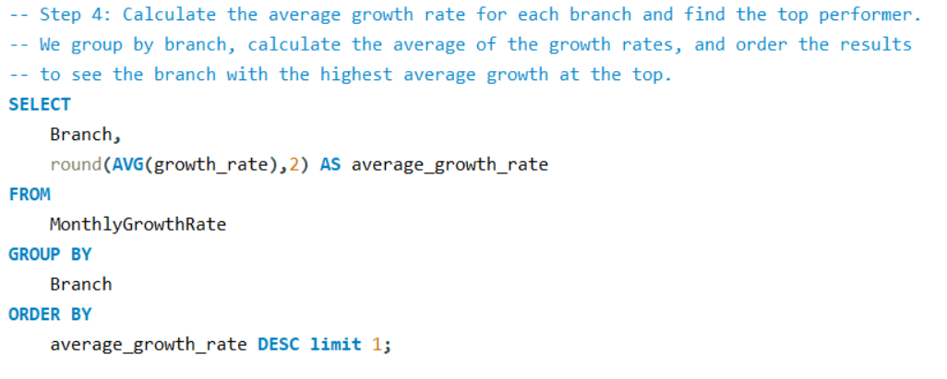


All Branched Growth Rate Over Time( without ‘ limit 1 ‘)
OUTPUT
OUTPUT (Only Top Performer )

Slide 6
Key Insight & Recommendation
Insight
Branch A demonstrated the highest average monthly sales growth, making it the top-performing branch in terms of growth momentum.
Recommendation
Walmart should investigate the strategies at Branch A.

Slide 7
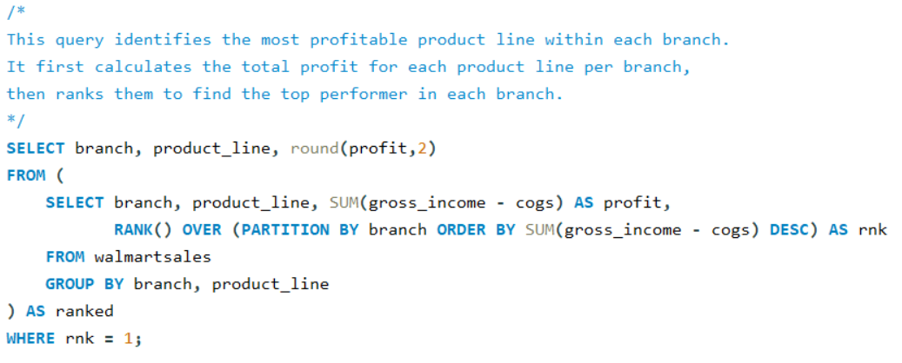
Task 2: Finding the Most Profitable Product Line for Each Branch
Business Question: Which product line generates the highest profit for each Walmart branch based on gross income and cost of goods sold?

Slide 8
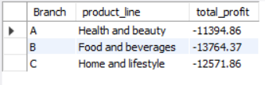
OUTPUT

Slide 9
Key Insight & Recommendation
Insight:
All three branches (A, B, and C) show losses in their top product lines.
Branch B has the highest loss in Food and Beverages (−13,764.37).
Branch A and C also show significant losses in Health and Beauty and Home and Lifestyle, respectively.
Recommendation:
Review pricing and cost structure for these product lines—COGS may be too high or pricing too low.
Analyze sales volume vs. cost to identify if low sales or high operational costs are driving losses.
Consider promotional strategies or bundling to boost sales in underperforming categories.
Evaluate product viability—discontinue or reposition products that consistently underperform.

Slide 10
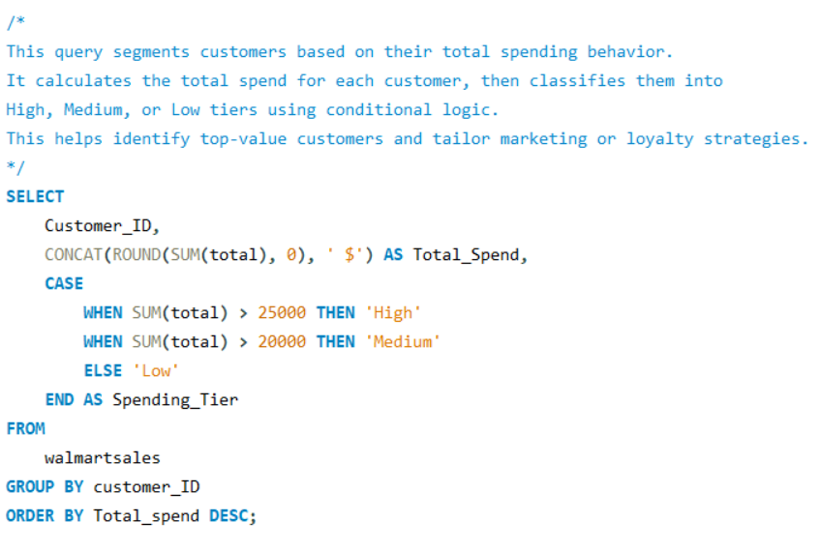
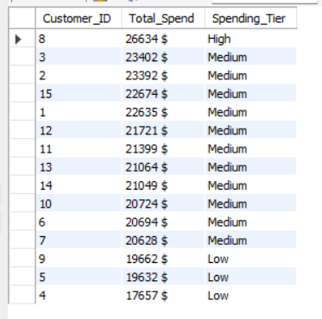
Task 3: Analyzing Customer Segmentation Based on Spending
Business Question: How can Walmart segment its customers into High, Medium, and Low spenders based on their total purchase behavior to optimize targeting and retention strategies?
OUTPUT

Slide 11
Key Insight & Recommendation
Insight:
Majority of top spenders fall under the Medium Spending Tier, despite spending over $20,000.
Only one customer is classified as High Tier, even though others have similar spend levels.
Customers with spend between $17,000–$20,000 are placed in the Low Tier, which may not reflect their actual value.
Recommendation:
Reevaluate tier thresholds to better align with actual spending behavior.
Consider creating a "Premium Medium" or "Upper Medium" tier to capture high-value Medium customers.

Slide 12
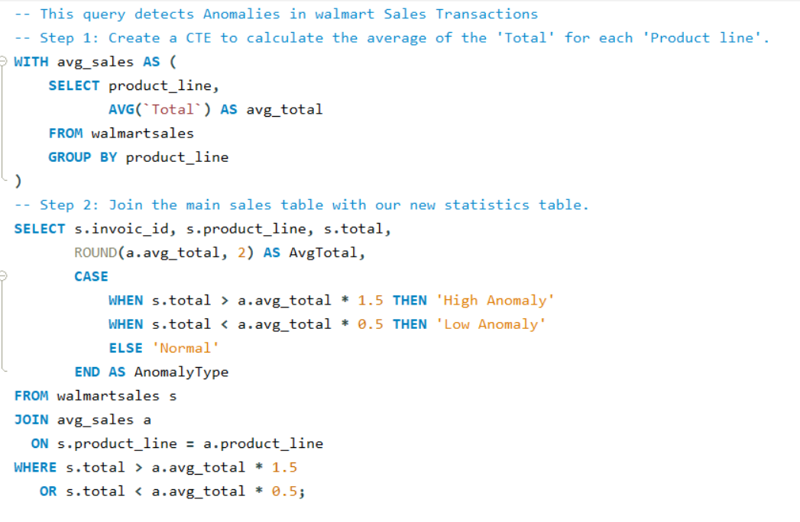
Task 4: Detecting Anomalies in Sales Transactions
Business Question: Which sales transactions significantly deviate from the average for their product line, indicating potential pricing or data anomalies?

Slide 13
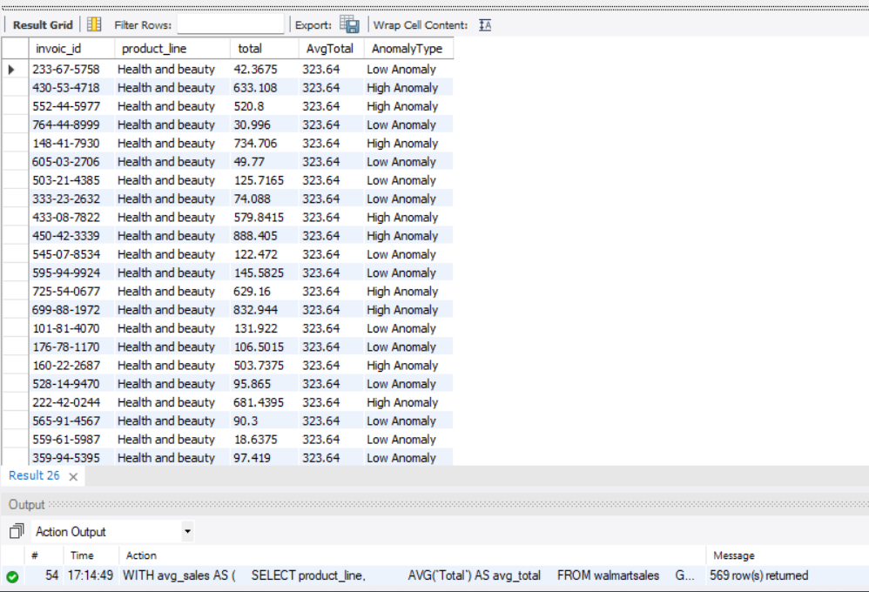
OUTPUT

Slide 14
Key Insight & Recommendation
Key Insights
Most of the unusual transactions are in the Health and beauty product line.
The average sale amount is around ₹323, but some sales are much higher or much lower.
High anomalies are above ₹485, and low anomalies are below ₹160.
This shows that some products might be overpriced or underpriced, or there could be mistakes in data entry.
These differences can affect how we understand customer spending and product performance.
Recommendations
Check the pricing of Health and beauty items to make sure it’s consistent.
Look into very low sales to see if there were discounts or errors.
Review high sales to confirm if they were correct or part of a bundle.
Try to group customers based on their buying patterns to learn more.

Slide 15
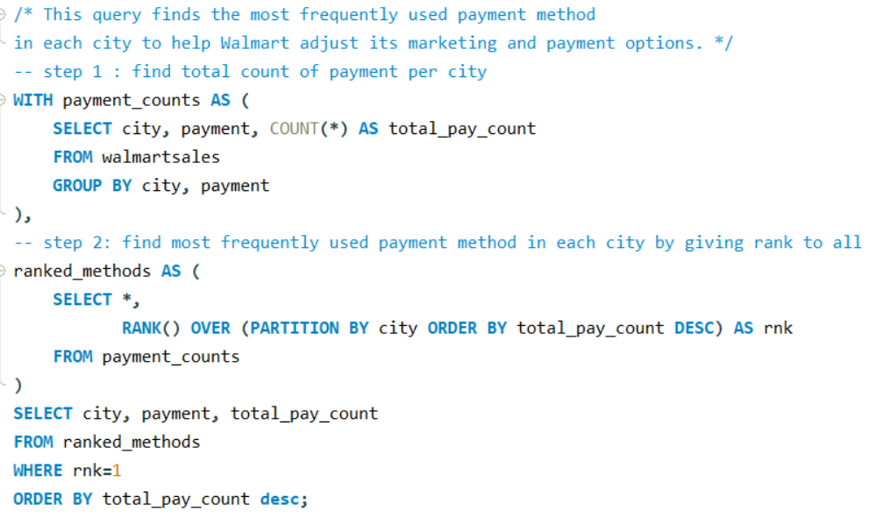
Task 5: Most Popular Payment Method by City
Business Question: What is the most preferred payment method in each city to help Walmart customize its local marketing and payment strategies?

Slide 16
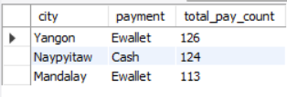
OUTPUT

Slide 17
Key Insight & Recommendation
Key Insights
Yangon and Mandalay customers mostly use Ewallet for payments.
Naypyitaw prefers Cash, showing less use of digital methods.
Ewallet is the most popular overall, but preferences vary by city.
Recommendations
Promote Ewallet offers in Yangon and Mandalay to match customer habits.
In Naypyitaw, encourage digital payments by offering discounts or rewards for Ewallet use.
Use this data to customize payment promotions for each city to improve customer experience and sales.

Slide 18
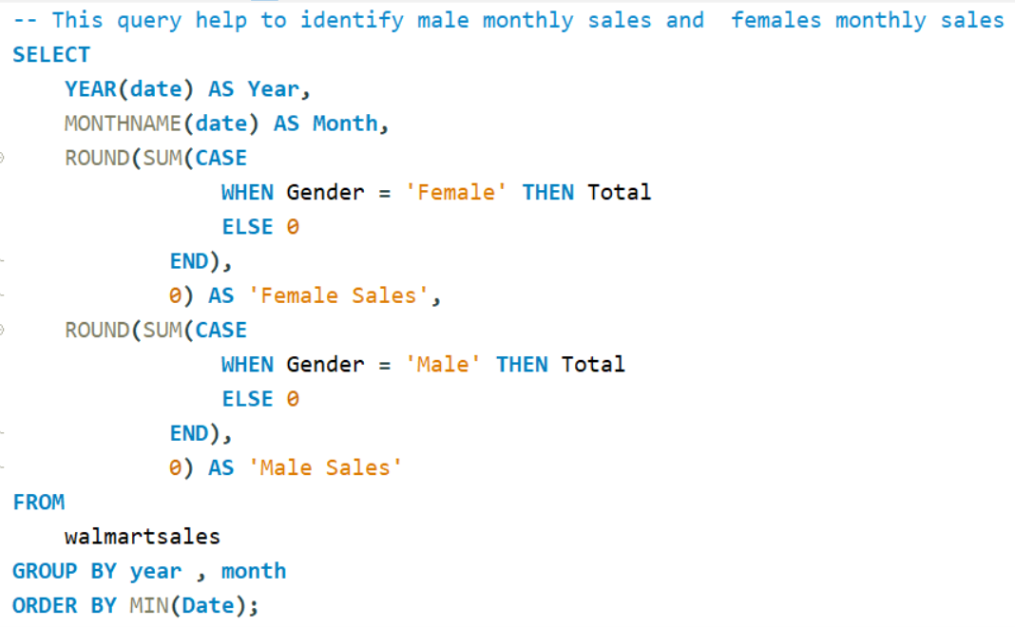
Task 6: Monthly Sales Distribution by Gender
Business Question: How do monthly sales differ between male and female customers, and which gender contributes more to sales each month?

Slide 19
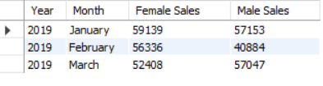
OUTPUT

Slide 20
Key Insight & Recommendation
Key Insights
In all three months (January to March 2019), female customers spent slightly more than male customers.
February shows the biggest gap, with female sales at ₹56,336 vs male sales at ₹40,884.
Overall, both genders contribute strongly to monthly sales, but female customers lead in total spending.
Recommendations
Create special offers for female customers, especially in months where their spending is higher.
Use this data to plan gender-focused promotions during peak months like February.
Keep tracking monthly trends to see if these patterns continue and adjust marketing strategies accordingly.

Slide 21
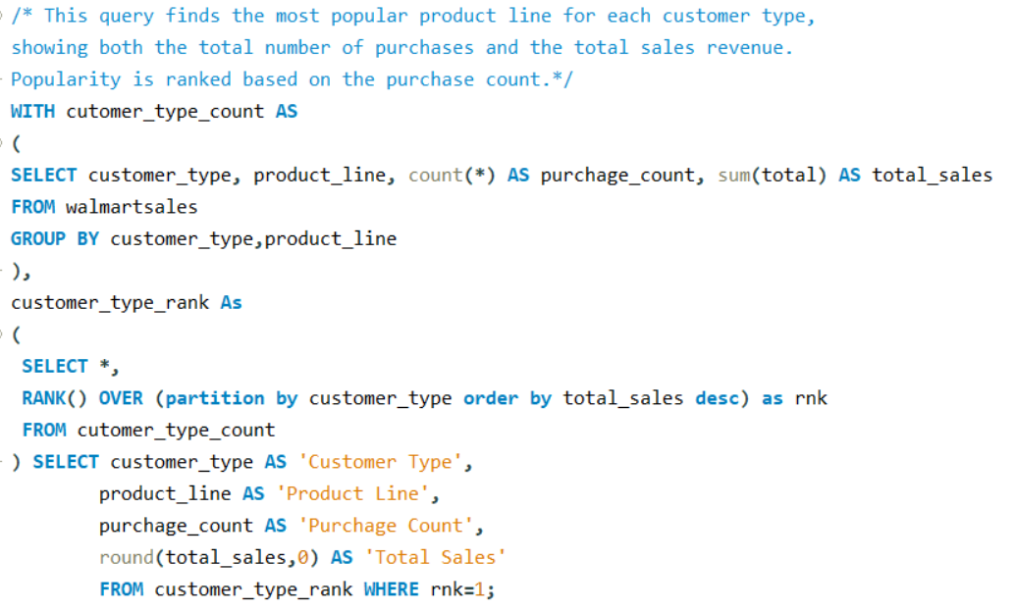
Task 7: Best Product Line by Customer Type
Business Question: Which product lines are most preferred by Walmart’s Member and Normal customers?

Slide 22

OUTPUT

Slide 23
Key Insight & Recommendation
Key Insights
Members prefer Food and beverages, both in number of purchases and total sales.
Normal customers spend the most on Electronic accessories, showing interest in tech products.
Each customer type has a distinct preference, which can guide targeted promotions.
Recommendations
Offer combo deals or loyalty points on Food and beverages for Members.
Promote gadgets and tech accessories to Normal customers through seasonal campaigns.
Use this data to personalize marketing and improve customer satisfaction.

Slide 24
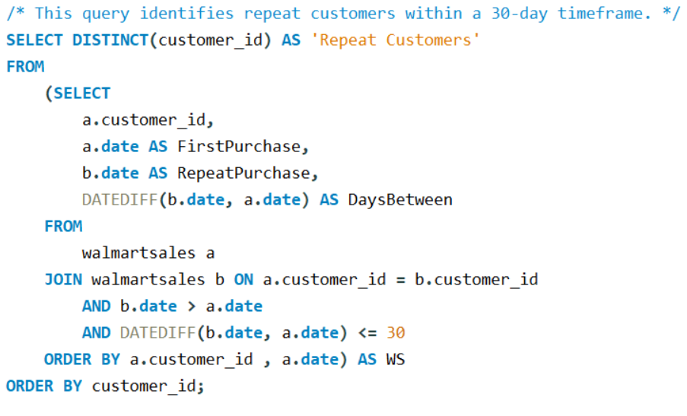
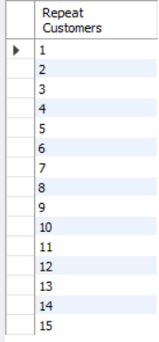
Task 8: Identifying Repeat Customers
Business Question: Which customers made repeat purchases within 30 days, helping Walmart understand loyalty and buying behavior?
OUTPUT
Note: Consider customer_id as customer

Slide 25
Key Insight & Recommendation
Key Insights
A total of 15 customers returned within 30 days — showing early signs of loyalty.
These repeat buyers may be more engaged, and could become long-term customers if nurtured.
Even with a small sample, this behavior shows potential for growth in customer retention.
Recommendations
Identify and reward these 15 repeat customers with special offers or loyalty perks.
Consider adding customer feedback or satisfaction surveys to understand why they returned.
Track repeat behavior monthly to see if the number grows — and adjust marketing accordingly.

Slide 26
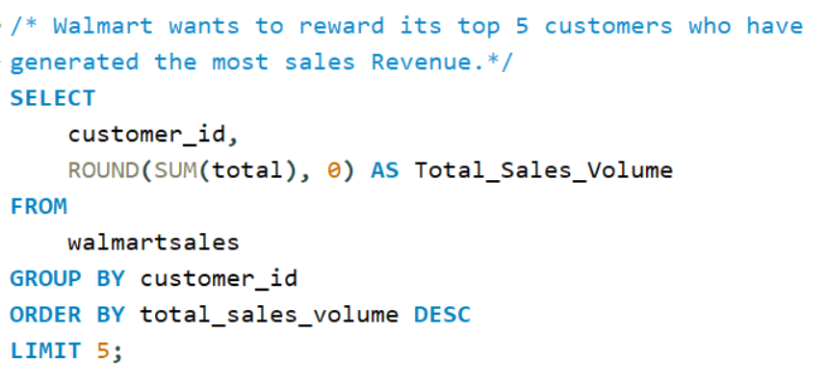
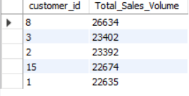
Task 9: Finding Top 5 Customers by Sales Volume
Business Question: Which customers have generated the highest sales revenue, so Walmart can recognize and reward its top contributors?
OUTPUT
Note: Consider customer_id as customer

Slide 27
Key Insight & Recommendation
Key Insights
Customer ID 8 is Walmart’s top spender, generating ₹26,634 in revenue.
The top 5 customers together contribute a significant portion of total sales.
These customers are likely high-value and loyal, worth special attention.
Recommendations
Reward these top 5 customers with exclusive offers, early access, or loyalty bonuses.
Analyze their buying patterns to replicate success with other customers.
Create a VIP program to retain and grow relationships with high-value buyers.

Slide 28
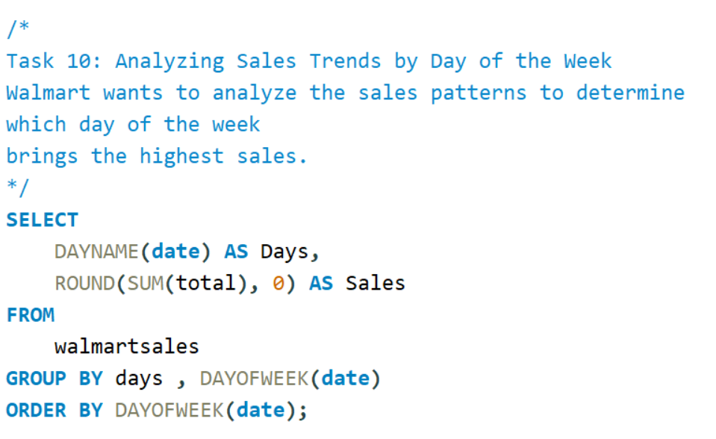
Task 10: Analyzing Sales Trends by Day of the Week
Business Question: Which day of the week generates the highest total sales, helping Walmart optimize staffing and promotions?

Slide 29
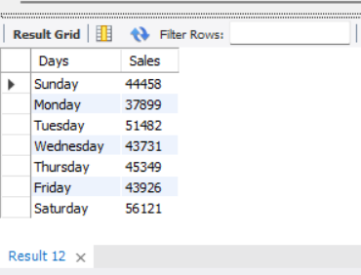
OUTPUT

Slide 30
Key Insight & Recommendation
Key Insights
Saturday has the highest sales — ₹56,121.
Tuesday also does well — ₹51,482.
Monday has the lowest sales — ₹37,899.
Other days are in the middle, with steady sales.
Recommendations
Add more staff and stock on Saturday — it’s the busiest day.
Run special offers on Monday to boost slow sales.
Use Tuesday for midweek deals — people are already buying.
Plan your store and marketing based on these day-wise trends.

Slide 31
Video Link
https://www.loom.com/share/a9fc2cb7b0234409ad22ded5324f870b?sid=7d8d6750-f22d-40d9-b53f-c43af99cd8e9
Thank you

